Slide 1
MGT10009 Contemporary Management Principles
Lecture 8 Org Structure
Dr David Qian dqian@swin.edu.au
Peter Moran pmoran@swin.edu.au
Notes:
1

Slide 2
Learning Objectives
5-1 Describe how different ethical perspectives guide decision making.
5-2 Explain how companies influence their ethics environment.
5-3 Outline a process for making ethical decisions.
5-4 Summarize the important issues surrounding corporate social responsibility.
5-5 Discuss reasons for businesses’ growing interest in the natural environment.
5-6 Identify actions managers can take to manage with the environment in mind.

Slide 3

It’s a Big Issue
Ethics are the system of rules that governs the ordering of values.
It’s often the rank-and-file employees who suffer most.
The right thing to do is not always evident or easy.
Notes:
This chapter explores ways of applying ethics, the moral principles and standards that guide the behavior of an individual or group. We do so based on the premise that employees, their employers, and their communities thrive over the long term when managers apply ethical standards that direct them to act with integrity.

Slide 4

It’s a Personal Issue
Most people have unconscious biases that favor themselves and their own group.
Managers often:
Hire people who are like them.
Think they are immune to conflicts of interest.
Take more credit than they deserve.
Blame others when they deserve the blame.
Notes:
This slide may be used to explore the challenge of ethical boundaries not always being clear.

Slide 5
Exhibit 5.1 Possible Outcomes of Lying and Telling the Truth 1
Reason for the Lie | Results of Lying | Results of Telling the Truth
Negotiation | Short-term gain and economically positive. Harms long-term relationship. Must rationalize to oneself. | Supports high-quality, long-term relationship. Develops reputation of integrity. Models behavior to others.
Conflicting expectations | Easier to lie than to address the. underlying conflict Does not solve underlying problem. Liar must rationalize the lie to preserve positive self-concept. | Emotionally more difficult than lying. May correct underlying problem. Develops one’s reputation as an honest person.
Notes:
This slide recreates Exhibit 5.1 and can be an introduction to the consequences of behavior.

Slide 6
Exhibit 5.1 Possible Outcomes of Lying and Telling the Truth 2
Reason for the Lie | Results of Lying | Results of Telling the Truth
To keep a confidence (that may require at least a lie of omission) | Maintains relationship with the party for whom confidence is kept May project deceitfulness to the deceived party | Violates a trust to the confiding party Makes one appear deceitful to all parties in the long run
To report your own performance (within an organization) | Might advance oneself or one’s cause Develops dishonest reputation over time | Creates a reputation of honesty and integrity. Performance report may not always be positive
SOURCE: Adapted from S. L. Gover, “The Truth, the Whole Truth, and Nothing but the Truth: The Causes and Management of Workplace Lying,” in The Academy of Management Executive: The Thinking Manager’s Source (Starkville, MS: Academy of Management, 2005).
Notes:
This slide recreates the second part of Exhibit 5.1 and can be an introduction to the consequences of behavior.

Slide 7


Ethics
Ethical issue:
Situation, problem, or opportunity in which an individual must choose among several actions that must be evaluated as morally right or wrong.
Business ethics:
Moral principles and standards that guide behavior in the world of business.
Notes:
Most people would agree that all of these values are admirable guidelines for behavior. However, ethics becomes a more complicated issue when a situation dictates that you must chooses one value over others.

Slide 8

Ethical Systems
Moral philosophy:
Principles, rules, and values people use in deciding what is right or wrong.
Universalism:
The ethical system stating that all people should uphold certain values that society needs to function.
Notes:
Moral philosophy refers to the principles, rules, and values people use in deciding what is right or wrong. This is a simple definition in the abstract but often terribly complex and difficult when facing real choices. How do you decide what is right and wrong? Do you know what criteria you apply and how you apply them?

Slide 9
Exhibit 5.2 Examples of Decisions Made under Different Ethical Systems
Universalism
A nonprofit organization treats all of its employees who work in different countries with fairness and dignity.
Egoism
An entrepreneur builds a successful company for personal growth and financial gain; and ultimately, employs thousands of employees.
Utilitarianism
Employees of a mid-sized company, after losing two major customers, accept a 10 percent reduction in salary so no one has to be laid off
Relativism
A college student refuses to share answers with a fellow student during an exam because her friends would do the same.
Virtue ethics
A manager believes that it is critical to stand up for what is right and not be unduly influenced by her manager or other organizational pressure.

Slide 10
Caux Principles
Caux Principles:
A regenerative, collaborative economic system that contrasts with the linear economy described earlier by minimizing input, waste, emissions, and energy leakage.
Kyosei:
Living and working together for the common good, allowing cooperation to coexist with healthy and fair competition.
Human dignity:
Concerns the value of each person as an end, not a means, to the fulfillment of others’ purposes.
Notes:
Ethical principles established by international executives based in Caux, Switzerland, in collaboration with business leaders from Japan, Europe, and the United States.
Two basic ethical ideals underpin the Caux Principles: kyosei and human dignity.

Slide 11
Egoism and Utilitarianism
Egoism:
An ethical system defining acceptable behavior as that which maximizes consequences for the individual.
Utilitarianism:
An ethical system stating that the greatest good for the greatest number should be the overriding concern.
Employees sometimes feel like “borrowing” a few office supplies from their company helps compensate for any perceived unfairness in pay or other benefits.
Notes:
According to egoism, acceptable behavior is that which maximizes benefits for the individual. “Doing the right thing,” the focus of moral philosophy, is defined by egoism as “do the act that promotes the greatest good for oneself.”
Unlike egoism, utilitarianism directly seeks the greatest good for the greatest number of people.

Slide 12
Relativism and Virtue Ethics
Relativism:
Philosophy that bases ethical behavior on the opinions and behaviors of relevant other people.
Virtue ethics:
Perspective that what is moral comes from what a mature person with good “moral character” would deem right.
Notes:
Perhaps it seems that an individual makes ethical choices on a personal basis, applying personal perspectives. But this is not necessarily the case. Relativism defines ethical behavior according to how others behave.
Virtue ethics is a perspective that says society’s rules provide a moral minimum, and then moral individuals can transcend rules by applying their personal virtues such as faith, honesty, and integrity.

Slide 13
Kohlberg
Kohlberg’s model of cognitive moral development:
Classifies people into categories based on their level of moral judgment.
Proposes three stages of development:
Preconventional.
Conventional.
Principled.
Notes:
Kohlberg’s model of cognitive moral development classifies people into categories based on their level of moral judgment.
People in the preconventional stage make decisions based on rewards and punishments and immediate self-interest.
People in the conventional stage conform to the expectations of ethical behavior held by groups or institutions such as society, family, or peers.
People in the principled stage see beyond authority, laws, and norms and follow their self-chosen ethical principles.
Some people forever reside in the preconventional stage, some move into the conventional stage, and some develop further yet into the principled stage. Over time, and through education and experience, people may change their values and ethical behavior.

Slide 14
The Ethics Environment
Sarbanes-Oxley Act:
An act passed into law by Congress in 2002 to establish strict accounting and reporting rules in order to make senior managers more accountable and to improve and maintain investor confidence.
Law requires companies to have more independent board directors to adhere strictly to accounting rules, and to have senior managers personally sign off on financial results.
Notes:
Responding to a series of corporate scandals—particularly the high-profile cases of Enron and WorldCom—Congress passed the Sarbanes-Oxley Act in 2002 to improve and maintain investor confidence. The law requires companies to have more independent board directors (not just company insiders), to adhere strictly to accounting rules, and to have senior managers personally sign off on financial results. Violations can result in heavy fines and criminal prosecution. One of the biggest impacts of the law was the requirement for companies and their auditors to provide reports to financial statement users about the effectiveness of internal controls.

Slide 15
Exhibit 5.3 Some Ethical Issues in Business 1
C E O pay:
What is a fair level of pay for a top executive?
Climate:
What is a company’s responsibility for its impact on the climate?
Globalization:
When a company operates in countries with lower costs, what are its obligations, if any, to the workers in those countries?
Health care:
Are employers ethically obliged to provide this benefit?
Notes:
Exhibit 5.3 is abbreviated on the slide.
Next slide contains:
Obesity
Online privacy
Social media
Wages

Slide 16
Exhibit 5.3 Some Ethical Issues in Business 2
Obesity:
What role should employer play in encouraging healthy employee lifestyles?
Online privacy:
What obligations do employers have in protecting the privacy of employee information and information about customers?
Social media:
What ethical obligations do employees have in commenting about their employer on social media? What ethical obligations do employers have concerning their employees’ privacy on social media?
Wages:
What should employers do to promote a sense that their compensation is fair?
Notes:
Exhibit 5.3 is abbreviated on the slide. The previous slide contains CEO pay, climate, globalization, and health care.

Slide 17
Ethical Climate and Leadership
Ethical climate:
In an organization, the processes by which decisions are evaluated and made on the basis of right and wrong.
Ethical leader:
One who is both a moral person and a moral manager influencing others to behave ethically.
Notes:
For employees, strong ethics climates can be a source of ethical personal actions plus pride, satisfaction, and commitment to the employer, while a weak culture or one that ignores ethics often causes unethical behavior or dissatisfaction and quitting.
You can have strong personal character, but if you “manage” ethics only by benign neglect, you won’t develop a reputation as an ethical leader.

Slide 18
Exhibit 5.4 Danger Signs of Unethical Behavior in Your Organization
Excessive emphasis on short-term revenues over longer-term considerations.
Failure to establish a written code of ethics.
A desire for simple, quick-fix solutions to ethical problems.
An unwillingness to take an ethical stand that imposes financial costs.
Consideration of ethics solely as a legal issue or a public relations tool.
Lack of clear procedures for handling ethical problems.
A response to the demands of shareholders at the expense of other constituencies.
Notes:
Maintaining consistent ethical behavior by all employees is an ongoing challenge. What are some danger signs that an organization may be allowing or even encouraging unethical behavior? Exhibit 5.4 (recreated on this slide) lists factors that could create a climate conducive to unethical behavior.

Slide 19
SPOTLIGHT ON . . . Digital Monitoring Can Help Ensure Ethics
Companies may use technology to enforce ethical behavior, as long as they inform the employees.
How would you feel knowing your messages are being monitored at work? How might you change your messaging habits, if at all?
What ethical implications for the employee-employer relationship does such surveillance pose?
Notes:
Stduent responses will vary for the first question. They may vary for the second as well, but referrals to Big Brother issues (but in the private sector) may come up.

Slide 20
Ethics Codes
Ways to make an ethics code effective:
Involve those who have to live with it in writing the statement.
Focus on real-life situations that employees can relate to.
Keep it short and simple, so it’s easy to understand and remember.
Write about values and shared beliefs that people can really believe in.
Set the tone at the top, having executives talk about and live up to the statement.

Slide 21
Ethics Programs
Compliance-based ethics programs:
Company mechanisms typically designed by corporate counsel to prevent, detect, and punish legal violations.
Integrity-based ethics programs:
Company mechanisms designed to instill in people a personal responsibility for ethical behaviour.
Notes:
Compliance-based ethics program elements include establishing and communicating legal standards and procedures, assigning high-level managers to oversee compliance, auditing and monitoring compliance, reporting criminal misconduct, punishing wrongdoers, and taking steps to prevent offenses in the future.
Integrity-based ethics programs go beyond the mere avoidance of illegality; they are concerned with the law but also with instilling in people a personal responsibility for ethical behavior. With such a program, companies and people govern themselves through a set of guiding principles that they embrace.

Slide 22
Ethical Decision Making
Ethical decisions require:
Moral awareness:
Realizing the issue has ethical implications.
Moral judgment:
Knowing what actions are morally defensible.
Moral character:
Strength and persistence to act in accordance with your ethics despite challenges.

Slide 23
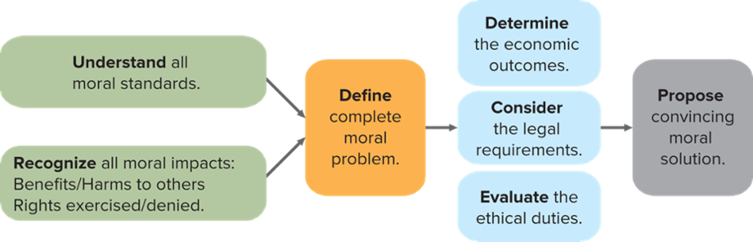
Exhibit 5.6 A Process for Ethical Decision Making
SOURCE: L. T. Hosmer, The Ethics of Management, 4th ed. (New York: McGraw-Hill/Irwin, 2003), p. 32. Fig. 5.1A.
Access the text alternative for slide image
Notes:
Thinking before deciding, and having an ethics-oriented conversation with others, can help you and others make more ethical decisions. You can use the process illustrated in Exhibit 5.6. Understand the various moral standards (universalism, relativism, etc.), as described earlier in the chapter.

Slide 24

Courage
Takes courage to take actions consistent with your ethics when others don’t want you to.
Plays a role in moral awareness involved in identifying an act as unethical.
Necessary when only ethical course of action is whistleblowing.
Notes:
Whistleblowing involves telling others, inside or outside the organization, about wrongdoing .

Slide 25
Corporate Social Responsibility 1
Stewardship:
Contributing to the long-term welfare of others.
Corporate social responsibility (C S R):
Obligation toward society assumed by business.
Triple bottom line:
Economic, social, and environmental performance.
Notes:
Corporate social responsibility (CSR) is the obligation toward society assumed by business. Corporate social responsibility reflects the social imperatives and the social consequences of business practices; it consists broadly of policies and practices that indicate business responsibility for some wider societal good.
CSR policies and actions take into account stakeholders’ expectations and often highlight the triple bottom line of economic, social, and environmental performance. The precise policies and practices underlying this responsibility lie at the discretion of the corporation.

Slide 26
Corporate Social Responsibility 2
Economic responsibilities:
Produce goods and services that society wants at a price that perpetuates the business and satisfies its obligations to investors.
Legal responsibilities:
Obey local, state, federal, and relevant international laws.

Slide 27
Corporate Social Responsibility 3
Ethical responsibilities:
Meeting other social expectations, not written as law.
Philanthropic responsibilities:
Additional behaviors and activities that society finds desirable and that the values of the business support.
Transcendent education:
Has five higher goals that balance self-interest with responsibility to others:
Empathy, generativity, mutuality, civil aspiration, and intolerance of inhumanity.

Slide 28
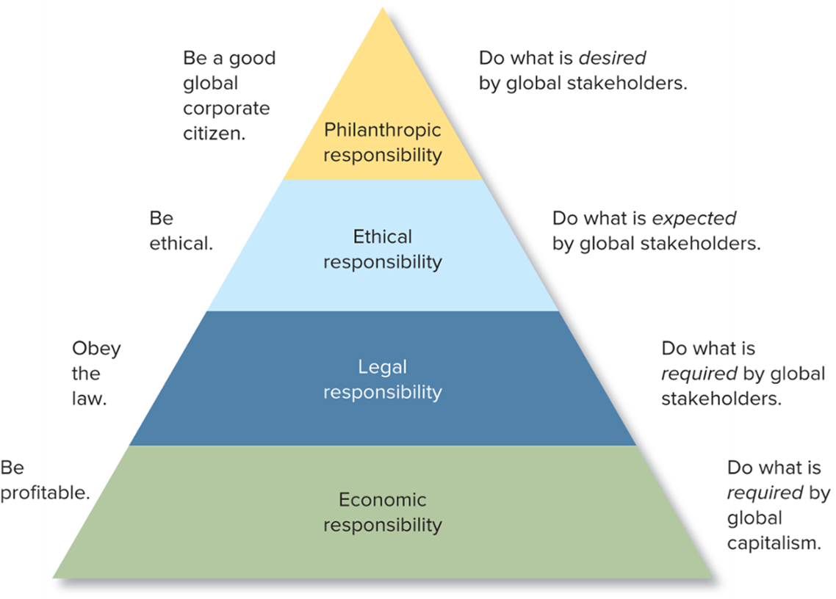
Exhibit 5.7 Pyramid of Global Corporate Social Responsibility and Performance
SOURCE: A. Carroll, “Managing Ethically with Global Stakeholders: A Present and Future Challenge,” The Academy of Management Executive (18, no. 2 (2004). pp. 114-20.
Access the text alternative for slide image
Notes:
Social responsibilities can be categorized as shown in Exhibit 5.7.

Slide 29
Contrasting Views
Two basic and contrasting views describe principles that guide managerial responsibility.
Managers act as agents for shareholders and, as such, are obligated to maximize the present value of the firm.
Managers should be motivated by principled moral reasoning.
Notes:
Two basic and contrasting views describe principles that guide managerial responsibility. The first holds that managers act as agents for shareholders and, as such, are obligated to maximize the present value of the firm. The second perspective, different from the profit maximization perspective, is that managers should be motivated by principled moral reasoning.

Slide 30
Reconciliation
Profit maximization and Corporate Social Responsibility seem paradoxical; managers regarded them as antagonistic, leading to opposing policies.
Recent attention has also been centered on the possible competitive advantage of socially responsible actions.
The U.S. Department of Agriculture and Coca-Cola North America are partnering to restore and protect damaged watersheds in national forests.
Notes:
The relationship between corporate social performance and corporate financial performance is complex; socially responsible organizations are not always more or less successful in financial terms.

Slide 31
Spotlight On… A College Built by and for the Poor
India’s Barefoot College is an educational organization working in 1,300 villages across 93 of the world’s least developed countries. Its mission is to improve rural lives and communities through learning-by-doing training.
In what ways are Barefoot College’s mission and goals characteristic of a social enterprise?
Which of Barefoot College’s guiding principles have you observed in environments in which you have worked or volunteered? Choose a principle you might not have observed and explain how you might try to incorporate it into a workplace?
Notes:
A College Built by and for the Poor
Barefoot College is based on the guiding principles of service and sustainability espoused by Mahatma Gandhi, along with a commitment to equality, shared decision making, and self-reliance. Its projects have brought artificial light to more than half a million people and provide clean water and solar energy for cooking and heating to thousands of communities
In what ways are Barefoot College’s mission and goals characteristic of a social enterprise?
Student responses will vary you may refer students to the discussion of social enterprises in Chapter 7.
Which of Barefoot College’s guiding principles have you observed in environments in which you have worked or volunteered? Choose a principle you might not have observed and explain how would you go about incorporating it into your current or a recent workplace?
Student responses will vary; however, they should refer to one of the ethical principles discussed in the chapter.

Slide 32

A Risk Society
By-products of wealth generation:
Industrial pollution risk.
Environmental risk.
Technological risk.
Notes:
Industrial pollution risks include air pollution, smog, global warming, ozone depletion, acid rain, toxic waste sites, nuclear hazards, obsolete weapons arsenals, industrial accidents and hazardous products.

Slide 33

Sustainable Growth
Sustainable growth:
Economic growth and development that meet present needs without harming the needs of future generations.
Sustainability is fully compatible with the natural ecosystems that generate and preserve life.
Notes:
Business used to look at environmental issues as a no-win situation, but a paradigm shift is taking place. At the same time, perhaps no time in history has offered greater possibilities for a change in business thinking than now. Some maintain that ecological sustainability is now the key driver of innovation.
Businesses are both a cause of and a solutions to the environmental degradation, and clearly have a major role to play in sustainability debates and strategies.

Slide 34
Life-Cycle Analysis (L C A)
L C A is a process of analyzing all inputs and outputs, through the entire “cradle-to-grave” life of a product, to determine total environmental impact.
Environmental reporting in the form of carbon footprints
Timberland pays particular attention to life-cycle analysis, as implied by this question on its recycled material shoe boxes.
Notes:
Increasingly, firms are paying attention to their total environmental impact throughout the life cycle of their products.
Life-cycle analysis (LCA) quantifies the total use of resources and the releases into the air, water, and land.
Carbon footprint: The output of carbon dioxide and other greenhouse gases.

Slide 35
Environmental Agendas for the Future
Collaborative efforts are essential—companies working with rather than against one another
Circular economy:
A regenerative, collaborative economic system that contrasts with the linear economy described earlier by minimizing input, waste, emissions, and energy leakage.

Slide 36
Management in Action I B M: Using Technology for the Greater Good
Science of Social Good Initiative launched, based on “applied science and technology can solve the world’s toughest problems; accelerating the rate and pace of solutions through the scientific method.”
I B M is sharing for free its new cloud and IA-powered technologies to help doctors and scientists learn more about the Covid-19 virus.
Notes:
IBM builds trust with the public by publishing its values and policies online, as well as an annual Corporate Responsibility Report. IBM describes itself as socially responsible in that it applies its expertise to social problems and empowers employees and others to serve their communities. In addition, the company says, “We integrate corporate citizenship and social responsibility into every aspect of our company.”
1. How is IBM’s commitment to corporate social responsibility good for IBM’s long-term profitability? Explain.
Students may disagree (giving reasons), but the text makes the case that being responsible can be good for business. IBM’s socially responsible conduct not only helps communities but also showcases the company’s problem-solving capabilities. They position the company as an expert at tackling difficult projects.
2. If you were managing a firm that had IBM’s resources IBM, what social and environmental issues would you prioritize?
Student answers may vary.

Slide 37
In Review
Describe how different ethical perspectives guide decision making.
Explain how companies influence their ethics environment.
Outline a process for making ethical decisions.
Summarize the important issues surrounding corporate social responsibility.
Discuss reasons for businesses’ growing interest in the natural environment.
Identify actions managers can take to manage with the environment in mind.
Notes:
This slide relists the chapter learning objectives and can be used to review the chapter highlights.
Chapter 6 will focus on international management.

Slide 38
End of Main Content
© 2023 McGraw Hill, LLC. All rights reserved. Authorized only for instructor use in the classroom. No reproduction or further distribution permitted without the prior written consent of McGraw Hill, LLC.

Slide 39
Accessibility Content: Text Alternatives for Images

Slide 40
Exhibit 5.6 A Process for Ethical Decision Making – Text Alternative
Return to parent-slide containing images.
First, you must understand all the moral standards and recognize all of the moral impacts. What are the benefits or harms to others? What rights are exercised or denied? Then, you will define the complete moral problem. This will help you determine the economic outcomes, consider the legal requirements, and evaluate the ethical duties. Finally, you will propose a convincing moral solution.
Return to parent-slide containing images.

Slide 41
Exhibit 5.7 Pyramid of Global Corporate Social Responsibility and Performance – Text Alternative
Return to parent-slide containing images.
The pyramid's bottom is economic responsibility. At this level, the corporation must be profitable, and it must do what is required by global capitalism. The second level of the pyramid is legal responsibility where the corporation must obey the law, doing what is required by the global stakeholders. The third level of the pyramid is ethical responsibility at which a corporation must be ethical and do what is expected by global stakeholders. The top of the pyramid is a corporation's philanthropic responsibility. At this level, the corporation must be a good global corporate citizen, doing what is desired by global stakeholders.
Return to parent-slide containing images.

